Slide 1
InterCatch –
the screen guide
Henrik Kjems-Nielsen
ICES Secretariat

Slide 2
The following presentation is a fast guide to InterCatch
This presentation must not be seen as a replacement of the InterCatch user manual.
The following presentation is a series of screen shoots of the steps/pages in InterCatch, which needs to be performed by the stock coordinators in order to process and estimate data in InterCatch.
There is more pages in InterCatch like data comparison pages and there is more allocation possibilities that shown here, but to limit the guide only the direct way through InterCatch is shown here.
A red line marker have been used in some of the screen shoots to mark selected or referred parts

Slide 3
Login and documents at ICES homepage
Find InterCatch manuals and links. On the ICES home page under Marine Data menu, Data Portals, InterCatch.
Please download and read the 5 page check list for stock coordinators on the InterCatch information page

Slide 4
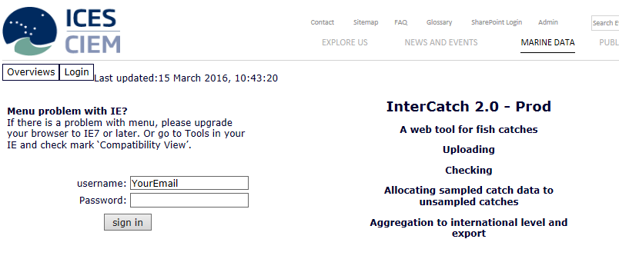
https://intercatch.ices.dk
If you are a stock coordinator or data submitter and you do not have a login for InterCatch please send an email to:
InterCatchsupport@ices.dk
Explain which stock your are stock coordinator for.
Your username is your email.
If you want your password reset please also send an email to:
InterCatchsupport@ices.dk

Slide 5
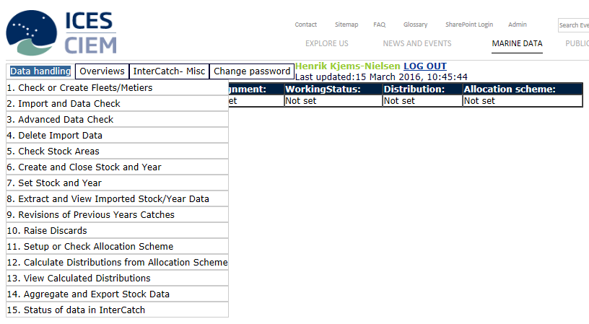
The menu overview

Slide 6
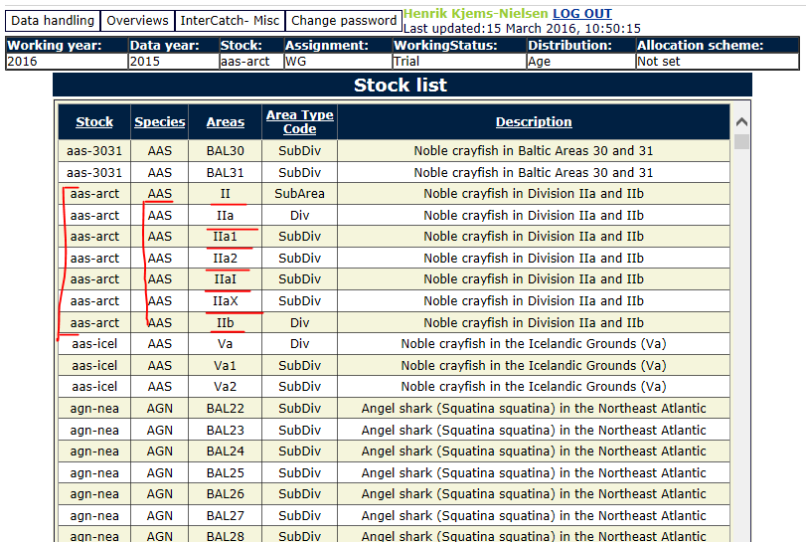
5. Check Stock Areas – to make sure all imported data will be extracted to your stock
It is essential that each stock coordinator check that all the areas that belong to your stock is set up in InterCatch.
If an area is missing in the Stock list overview, then catch and sample data imported to the missing area will never be extracted to you stock data.
A complete list of Areas can be found in the main menu Overviews and Areas.
Please also be aware of the species code.

Slide 7
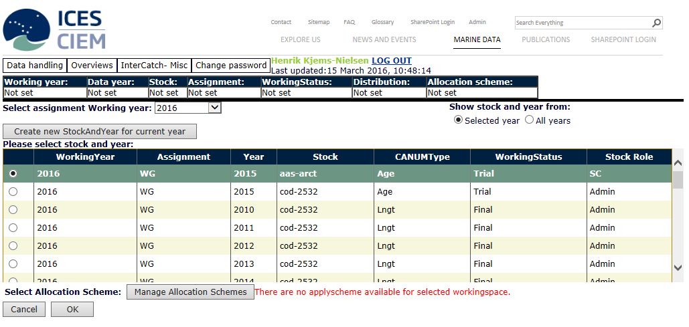
7. Set Stock and Year - tell InterCatch which stock and year you will work with
Tell InterCatch which stock and year you work with.
If no stock and year are shown in the list, please press ‘Create new Stock and Year for current year’ or go to menu item ‘6. Create and Close Stock and Year’ and create a new stock and year.

Slide 8
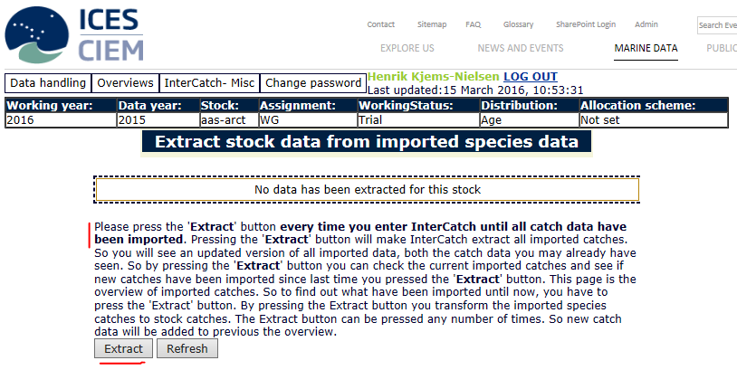
8. Extract and View Imported Stock/Year Data – to extract all imported data to your stock
Please read all the text in the screen shoot.
The species and area rules for the stock, which was checked before, are the rules the Extract uses to extract the stock data from all imported species and areas.

Slide 9
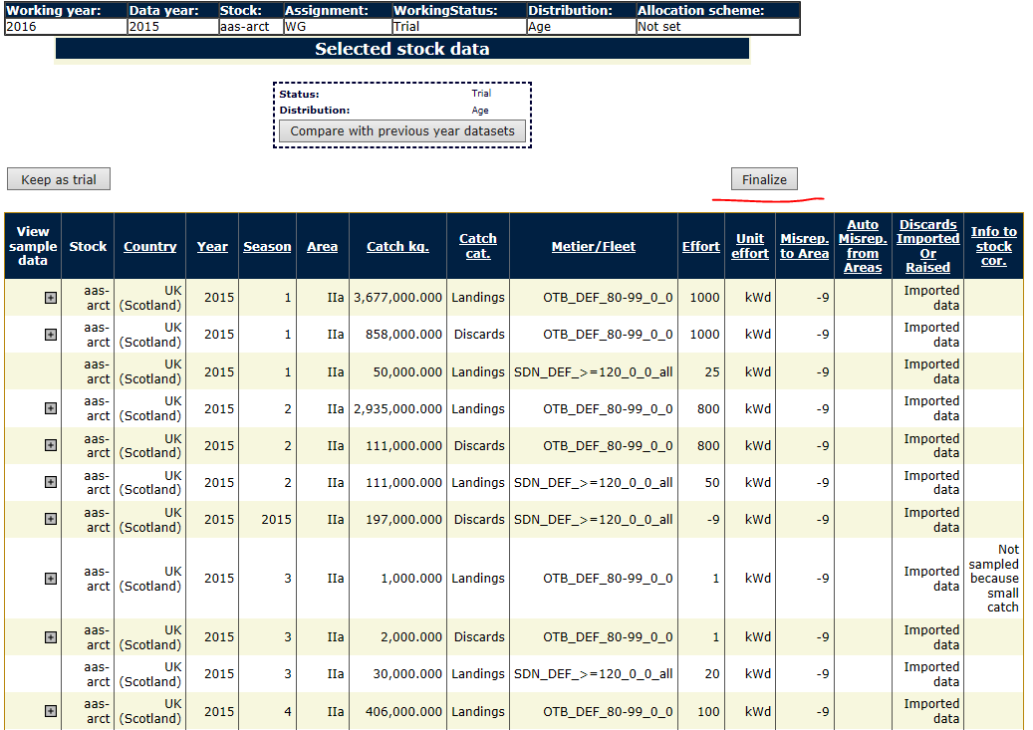
8. Extract and View Imported Stock/Year Data – finalise when all data are imported and Extracted
A plus sign ‘+’ in the 1st column ‘View Sample Data’, means that there is sample data for the strata. The sample data can be viewed by pressing the plus sign.
Check if all countries have imported all data and all data looks ok, then finalise the data.
You can press ‘Compare with previous years datasets’

Slide 10
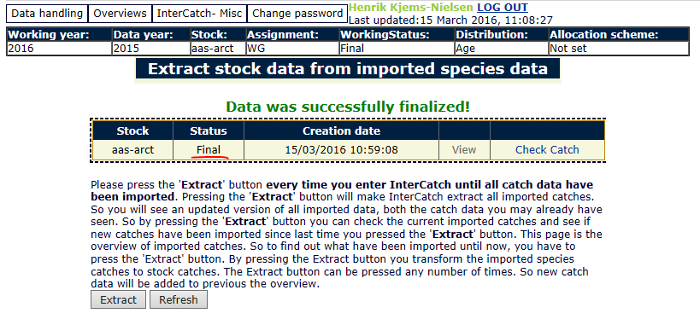
8. Extract and View Imported Stock/Year Data – check countries and data
Now all your stock data is in status final and you can start the estimations.
If your data is in status trial, then you press ‘View’ and then ‘Finalise’.
You can get an overview of catches per country per quarter and catch category by pressing ‘Check Catch’.

Slide 11
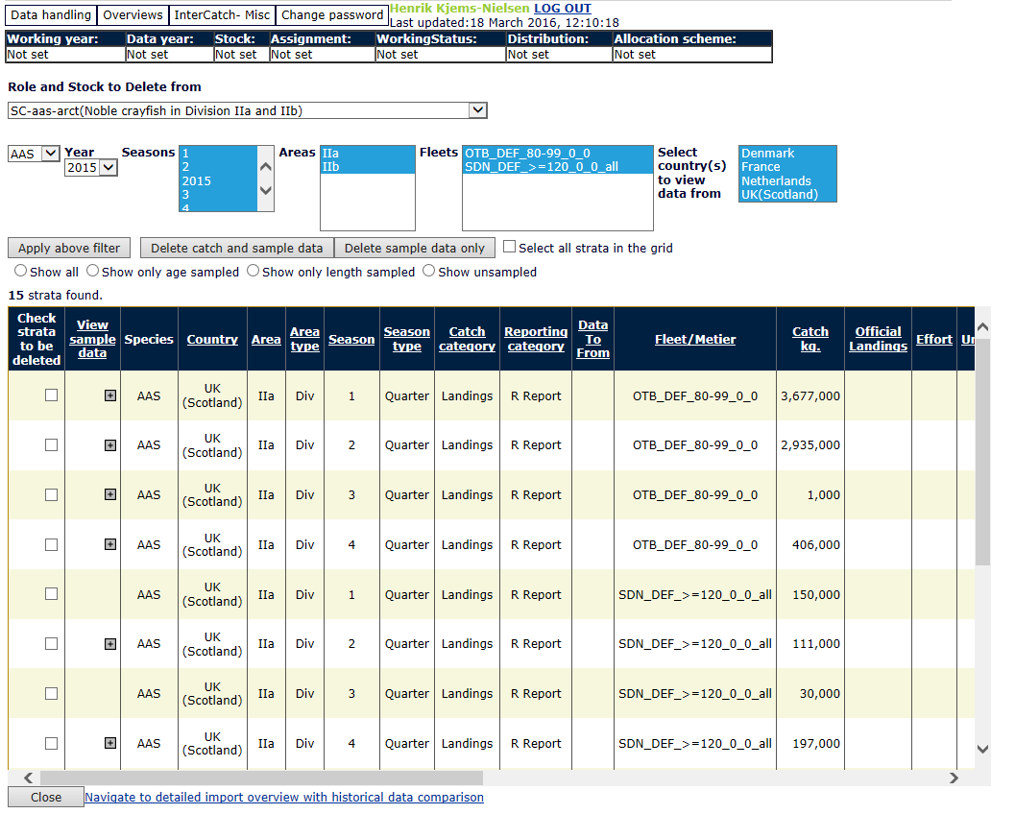
4. Delete Import Data – Always Extract afterwards
After you or the data submitter have deleted imported data, you must always extract data again to see the effect in the stock data. ‘Imported data’ is one part of InterCatch, the extracted ‘stock data’ in trial or final is another data set, which is not directly affected by a delete of imported data.
For data submitters: If you cannot see data you have imported, then it is because you have not been set up for the specific species/stock, please send an email to:
InterCatchsupport@ices.dk

Slide 12
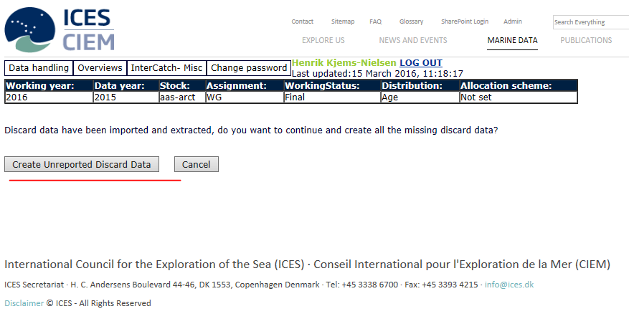
10. Raise Discards – if the stock should have discards for all strata
Press the button ‘Create Unreported Discard Data’ if you need to estimate discards for all strata, which does not have imported discards.
If the stock only have a few discard strata but these are not used for estimating discards for all other strata, then you should not press the ‘Create Unreported Discard Data’.
When you press the ‘Create Unreported Discard Data’, InterCatch will create a discard stratum for each stratum where there is a landing but no discard.

Slide 13
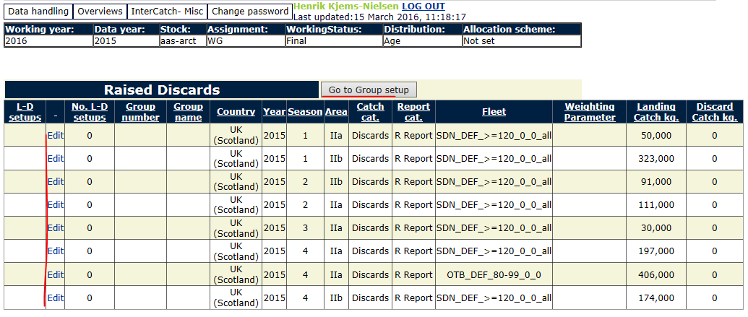
10. Raise Discards – Raised discard strata created
Raised discard strata created.
Go to Group setup or edit each raised discard strata individual.

Slide 14
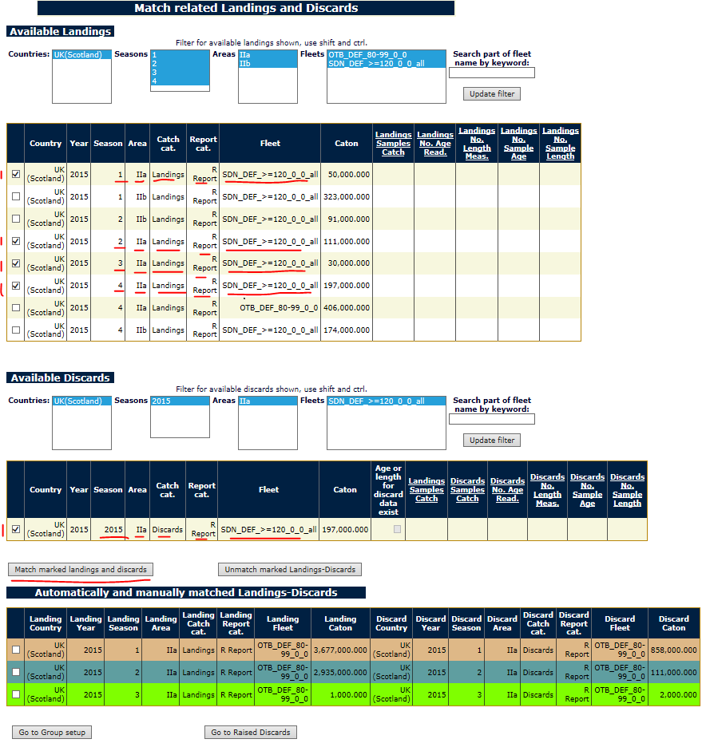
10. Raise Discards
The very first time you try to set up Groups or edit individual raised discard strata, you will automatically be redirected to the ‘Match related Landings and Discards’ page for making ratios for landings and discards.
In the table at the bottom (in colours) you see the strata where there is both a landing and a discard weight imported, for which the ratio between the landing weight and the discard weight can be used to estimate raised discard. These are automatically found by InterCatch. But you can manually match e.g. quarterly landings (top table) to an annually discard (mid table) for the same stratum (country, area, fleet/metier and reporting category).

Slide 15
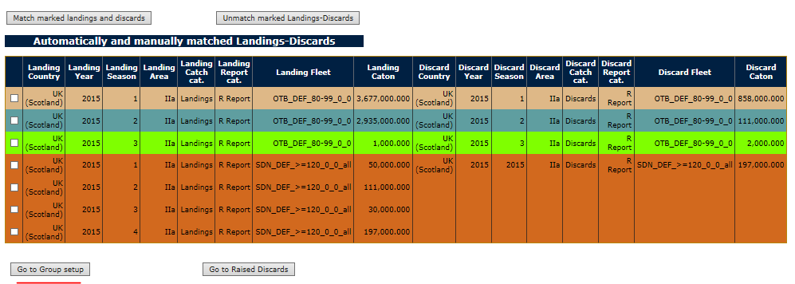
10. Raise Discards – land-disc ratios to use
The table at the bottom of the ‘Match related Landings and Discards’ page. Showing strata for which both landings and discards have been imported. Therefore InterCatch can calculate a ratio between landings weights and discard weight, which can be used for estimating raised discards weights. The strata that is brown have 4 quarterly landings matched to 1 annually discard, which just have been set up manually. The strata above with landing-discard ratios are the strata, which can be selected for estimating the raised discards.

Slide 16
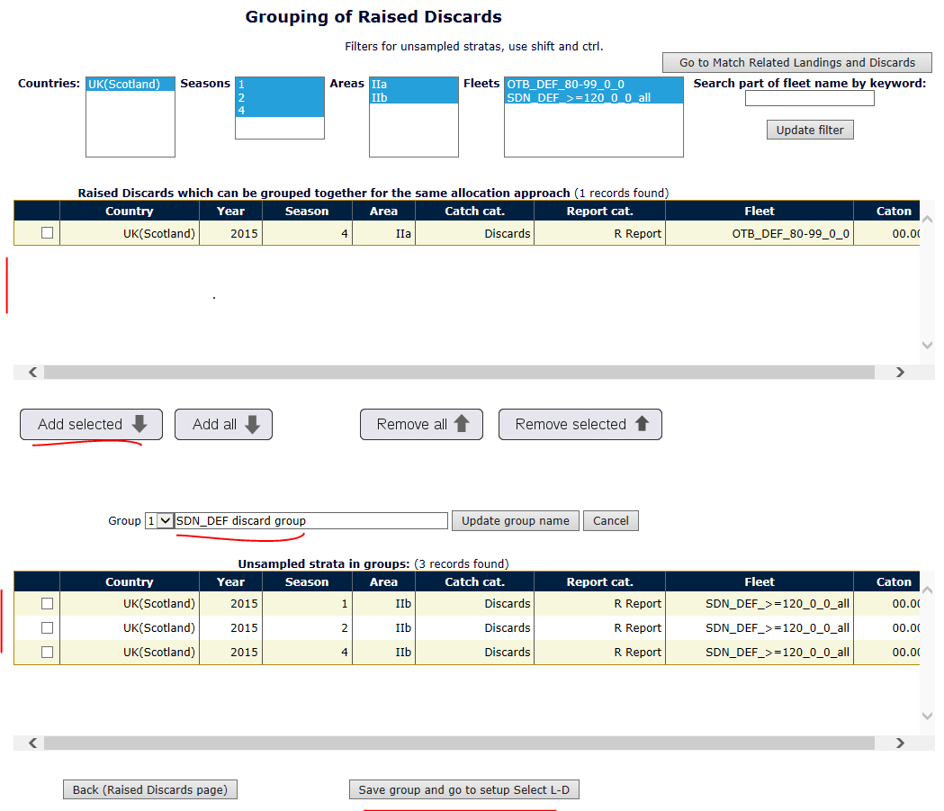
10. Raise Discards – Set up groups
Select raised discard strata that should be using the same landing-discard ratios for estimating the raised discard weights.

Slide 17
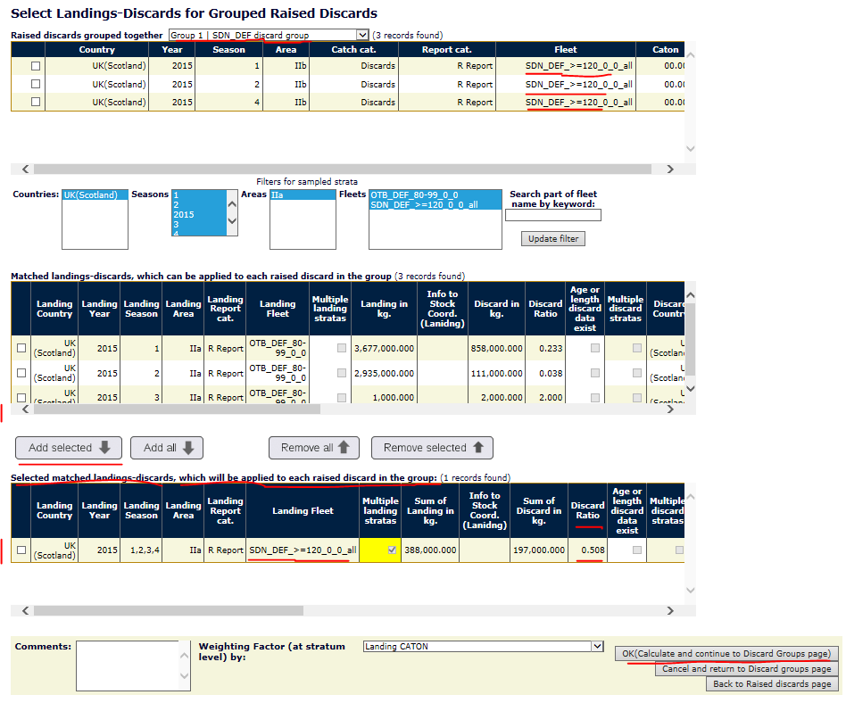
10. Raise Discards – Set up groups’ ratios
Select the landing-discard ratios (select the strata) for estimating the raised discard group. That is done by selecting the stratum with the ratio.
Any number of Landing-discard strata (with a ratio can be selected), in this example only one was selected.
The selected stratum/ratio is the one with 4 quarterly landings and 1 annual discard (yellow field).

Slide 18
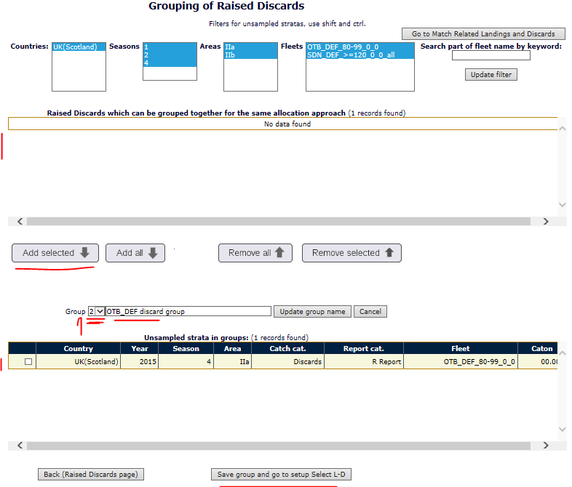
10. Raise Discards – Set up groups (2)
To set up the next raised discard group click the small arrow down after the ‘Group’-field in the middle of the page and select the number ‘2’.

Slide 19
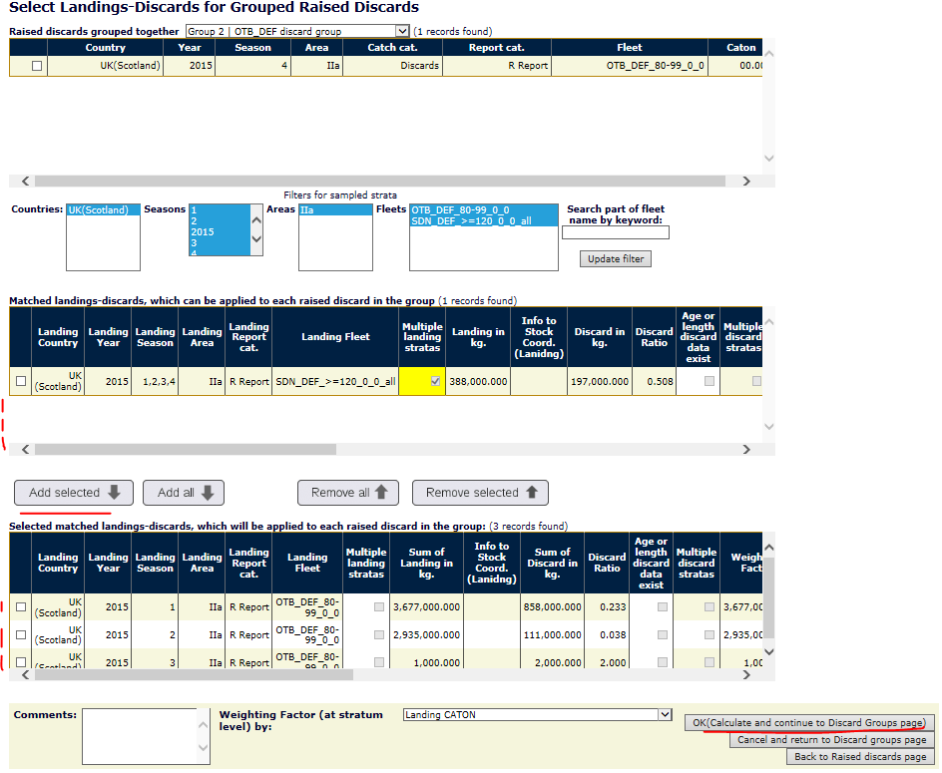
10. Raise Discards – Set up groups’ ratios (2)
Select the strata-ratios for estimating the raised discard group 2.
When all raised discards are calculated go back to the raised discards page.

Slide 20
10. Raise Discards – Raised discard strata weight estimated
See that for all raised discard strata there is now an estimated discard weight.
Compare this slide with the slide ‘10. Raise Discards – Raised discard strata created’ (slide number 11) and see that 4 strata have been removed. That is because the 4 quarterly landing strata was matched to 1 annually discard strata. So there should not be a created/estimated a raised discard weight for each of the 4 quarterly landing strata, which was matched the annual discards stratum.

Slide 21
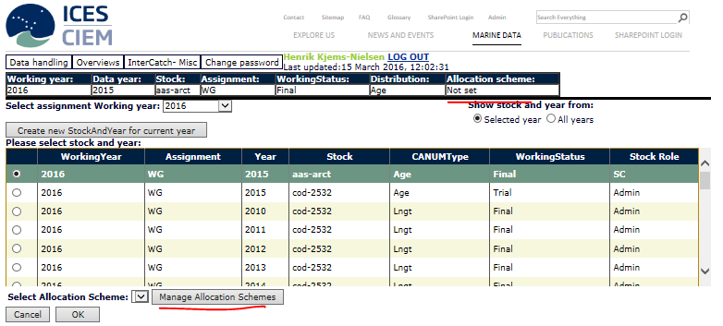
7. Set Stock and Year – allocation scheme
Before going into menu ‘11. Setup or Check Allocation Schemes’ and making allocations, a new allocation scheme have to be created. Select the relevant stock and year in the table, and then press ‘Manage Allocation Schemes’.

Slide 22
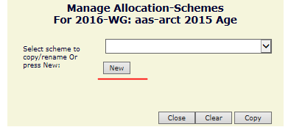
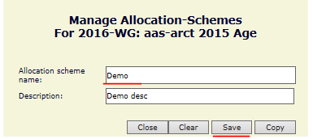
7. Set Stock and Year – alloc. Scheme new
Press ‘New’ to make a new allocation scheme, and a new window will appear.
Give the allocation scheme a name and save.

Slide 23
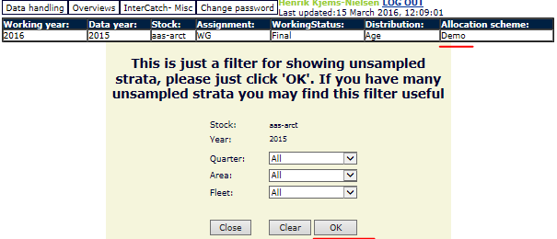
11. Setup or Check Allocation Schemes
Press ‘Ok’ to select all unsampled strata – this is just a filter for the very large stocks with many unsampled strata.
Then press ‘Yes’ in the next page to let InterCatch find all the unsampled strata.

Slide 24
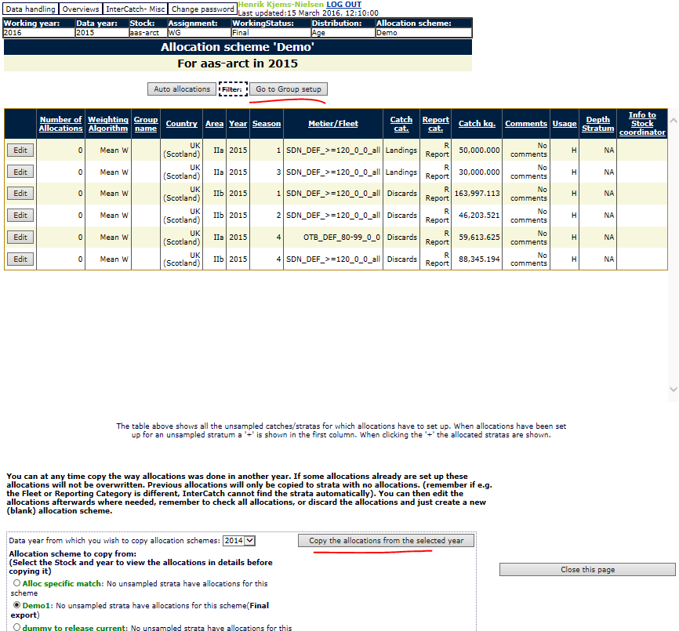
11. Setup or Check Allocation Schemes
There are 4 options to make allocations:
Group setup
Copy previous years allocations – look at the bottom of the page, scroll down
Automatically set (Auto allocations) - based on same parameters from the unsampled and the sampled strata
Edit of each individual strata (time consuming)

Slide 25
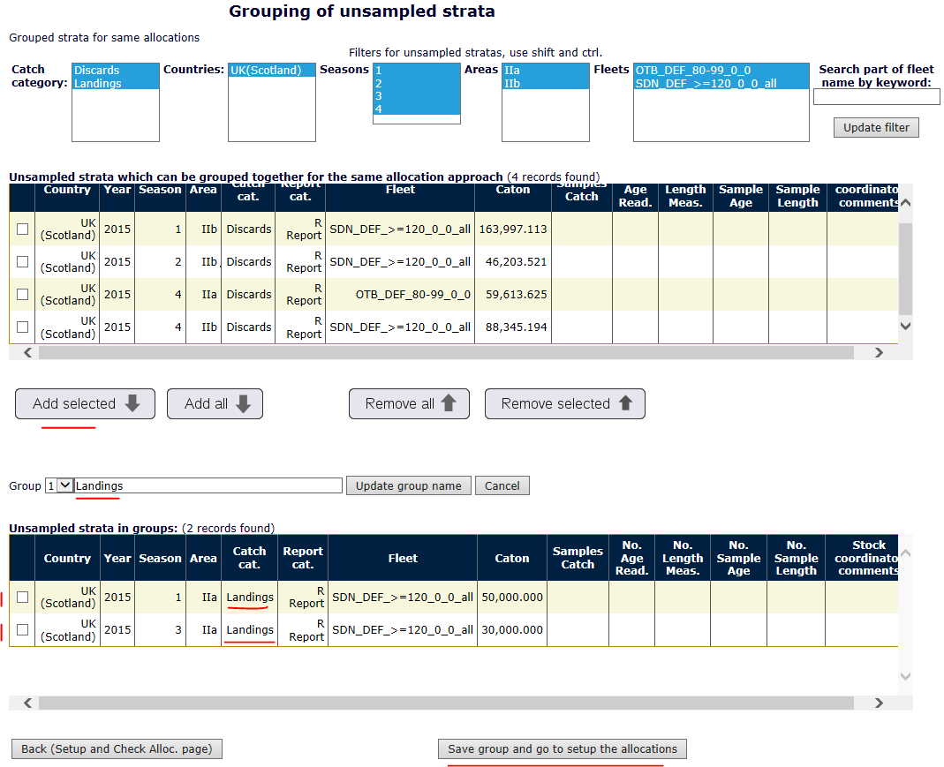
11. Setup or Check Alloc.- groups
This example show how to use the Groups to make allocations.
Select unsampled strata into a group which will use the same sampled strata to estimate/raise the age distribution (or length – if length distributed stock).

Slide 26
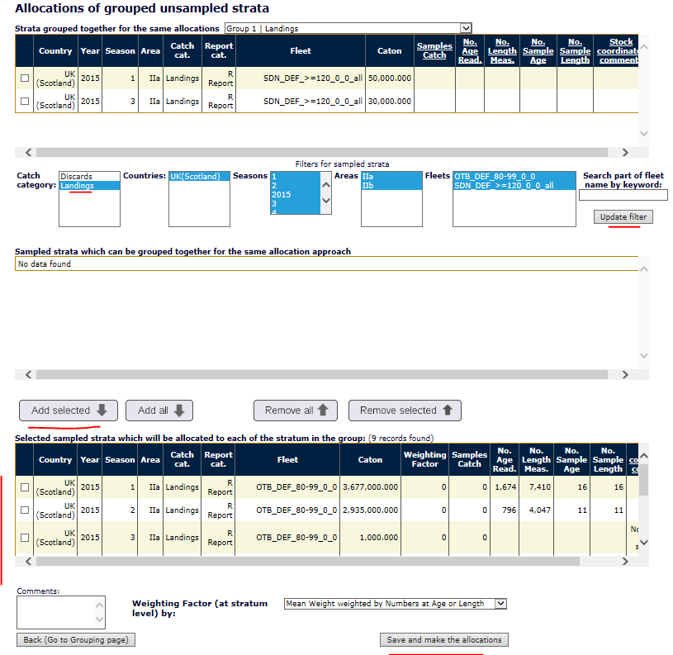
11. Setup or Check Alloc.- groups samples
Select the sampled strata, which will be used to estimate/raise the age distribution for group 1: ‘Landings’

Slide 27
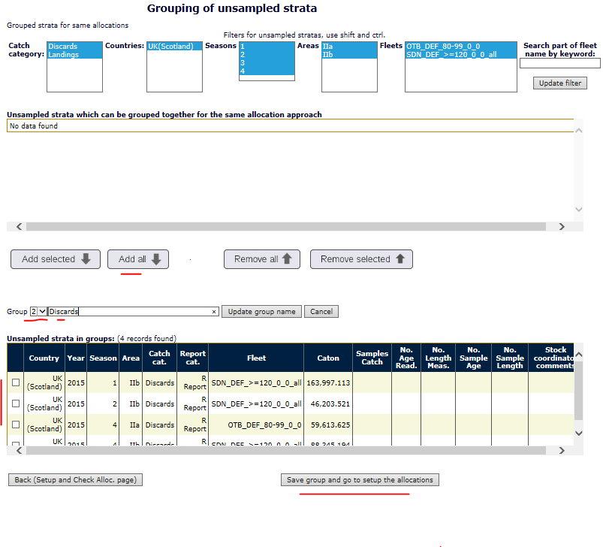
11. Setup or Check Alloc.- groups (2)
Go to the new empty group by pressing the small arrow down next to the Group field in the middle of the page.
Select unsampled strata into the group, which will use the same sampled strata to estimate/raise the age distribution (or length – if length distributed stock).

Slide 28
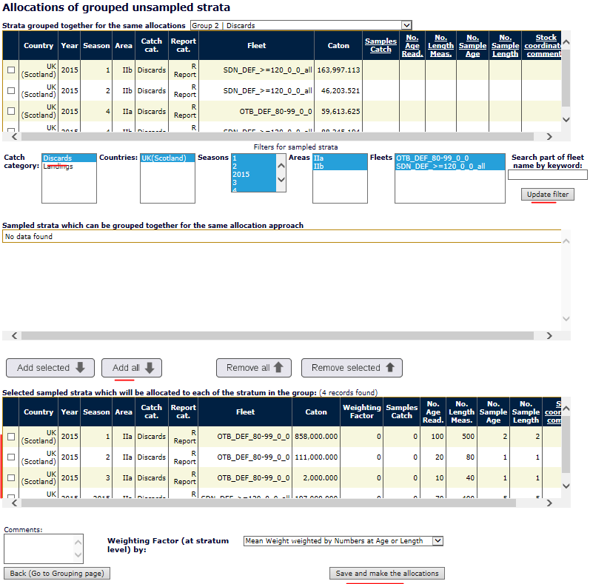
11. Setup or Check Alloc.- groups samples 2
Select the sampled strata, which will be used to estimate/raise the age distribution for group 2 called ‘Discards’ see the very top.

Slide 29
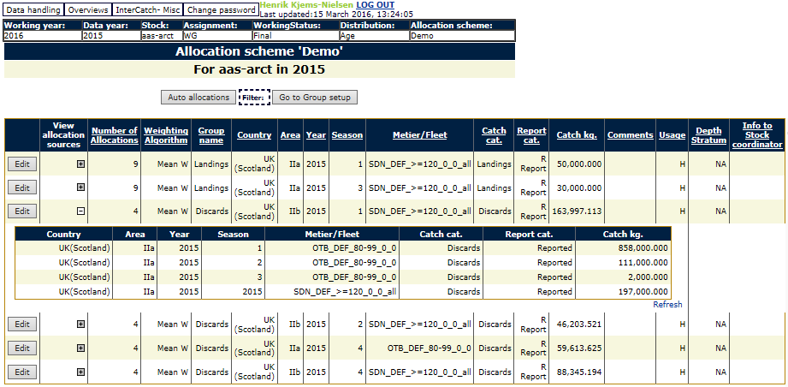
11. Setup or Check Allocation Schemes
Click the plus sign ‘+’ to see which sampled strata are allocations to each unsampled stratum

Slide 30
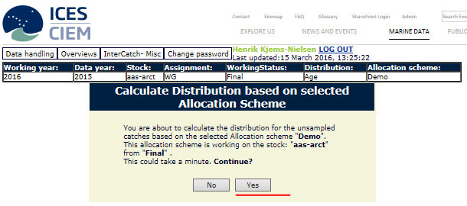
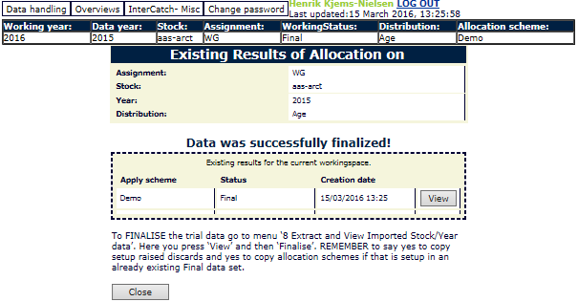
12. Calculate Distributions from Allocation Scheme
Calculate the age distribution based on the current allocation scheme.
Press ‘Yes’ to let InterCatch calculating the estimated/raised age distribution for the unsampled strata.
The age distribution can be viewed for all the unsampled strata by pressing ‘View’ and then the plus sign ‘+’.

Slide 31
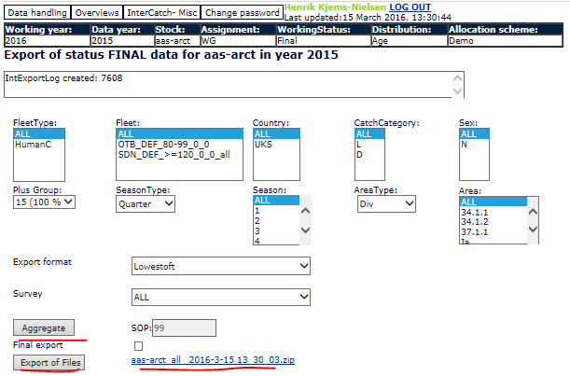
14. Aggregate and Export Stock Data
When aggregating and exporting all the data please select ‘All’ in all fields, this will ensure you get all the data belonging to your stock.
SeasonType and AreaType does not matter as long as you select ‘All’ in the Season and Area. You should not specify the individual areas for the stock, ‘All’ will make sure all areas are taken.
If you make specific selections in some of the fields be aware that only the caton.txt, canum.txt and weca.txt output files will depend on your selection, all other exported files will take all data for the stock.
After ‘Aggregate’ and ‘Export of file’ have been pressed right click the zip-file link and select ‘Save target as’ and save the zip-file on your harddisk.

Slide 32
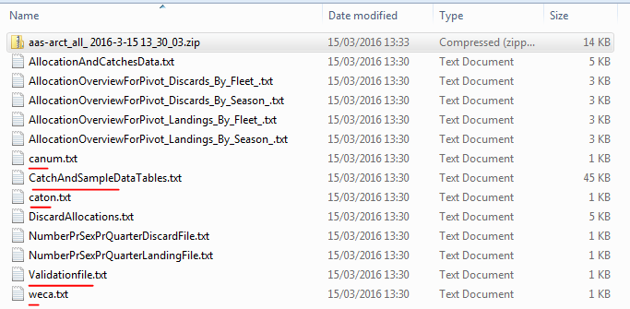
14. Aggregate and Export Stock Data
Look first in the Validationfile.txt and verify the exported data looks correct.
The caton.txt (total catch weight), canum.txt (total numbers at age or length) and weca.txt (mean weight at age or length) files are the primary files.
In the CatchAndSampleDataTables.txt many overviews for the report are present. Further down in the file Table 1 contains all strata with catch weight which is useful for pivot tables. Further down Table 2 contains all imported and estimated data, to look into details of sample and estimated age or length data.

Slide 33
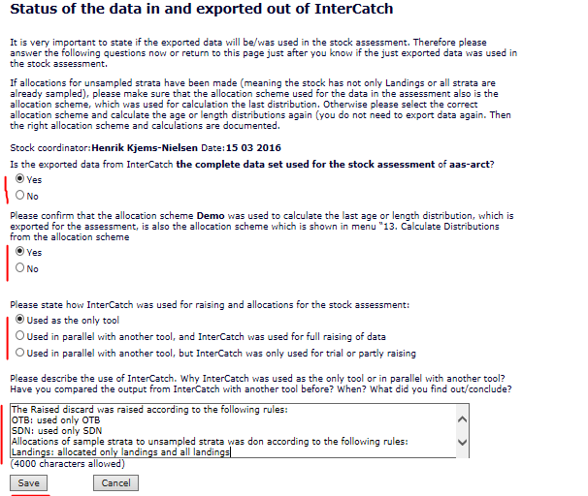
15. Status of data in InterCatch
It is very important the ‘15. Status of data in InterCatch’ is filled in so ICES Secretariat knows if the data in InterCatch is the documentation of the data and processes in InterCatch of the stock assessment.
Please write which approach that have been take regarding raised discard and allocations of sampled strata to unsampled strata in the text box.

Slide 34
New data have been imported then what
The next few slides shows that existing raised discard setup and allocation work can be copied if new data have been imported.

Slide 35
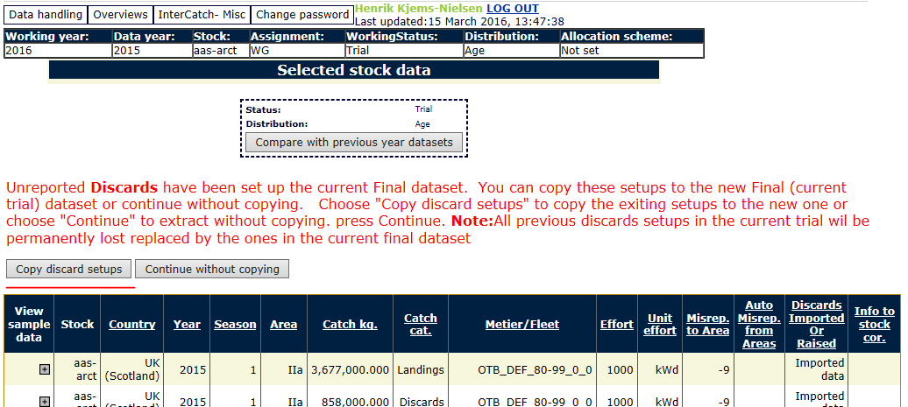
8. Extract and View imported Stock/Year Data
If new data have been imported after raised discards and sampled allocations have been made, a new export of updated data can be made fast, if the update only contains updated values and no new strata (otherwise it takes a little longer because you have to do some allocations).
It is done by Extracting the new imported data into trial and the finalising the data. When you finalise InterCatch will ask you if you want to ‘Copy discard setups’, which you press, if you want InterCatch to copy the work have done with the data in the final status.

Slide 36
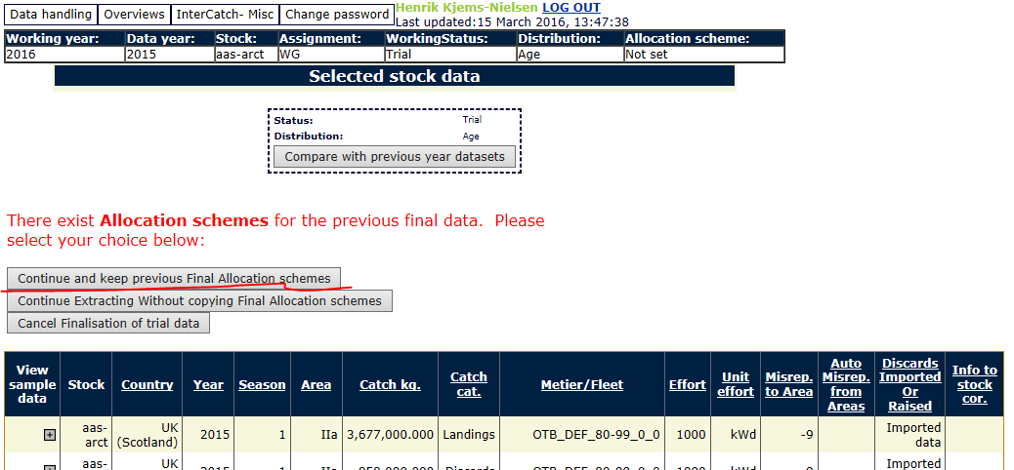
8. Extract and View imported Stock/Year Data
Right after you are asked if you want to keep the previous final allocation schemes, which you press to keep the allocations you have made.
Remember to calculate the age distribution based on the current allocation scheme in menu item ‘12. Calculate Distributions from Allocation Scheme’ otherwise the distribution is not calculated

Slide 37
12. Calculate Distributions from Allocation Scheme
Calculate the age distribution based on the current allocation scheme.
Press ‘Yes’ to let InterCatch calculating the estimated/raised age distribution for the unsampled strata.
The age distribution can be viewed for all the unsampled strata by pressing ‘View’ and then the plus sign ‘+’.
Then export and fill in the status page.

